Slide 1
Experiments Slide Deck
Sanyam*Stefano
Østfold University College

Slide 2
Experiment 1

Slide 3
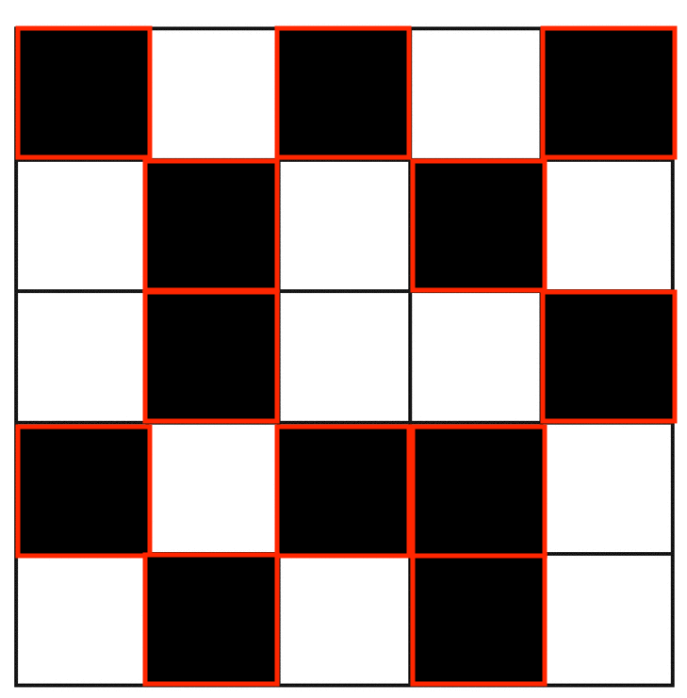
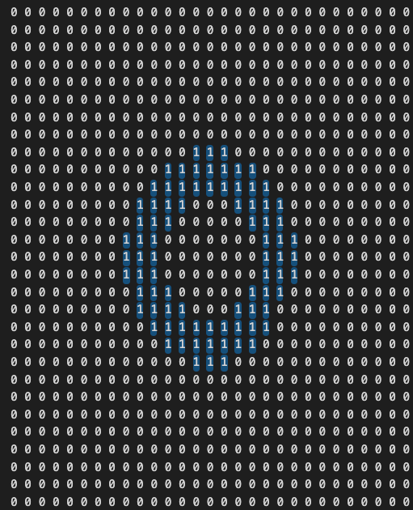
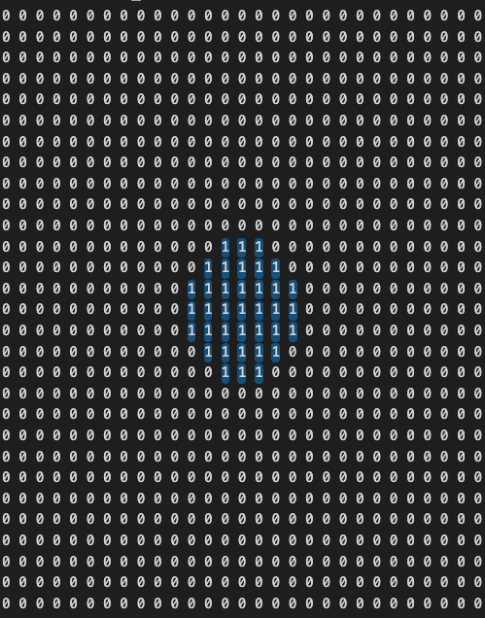
Fixed MNCA details for experiment1
Initial State - Random with probability (0,1)
W=100
H=100
Border Conditions = wrap_around
CASteps = 1-50
Fixed 2 neighbors ➔ ➔ ➔ ➔ ➔ ➔ ➔ ➔ ➔
mask_c1
mask_c2

Slide 4
A pictorial explanation for a population
[
[ [(_,_,_), (_,_,_), (_,_,_), (_,_,_)],
[(_,_,_), (_,_,_), (_,_,_), (_,_,_)],
[(_,_,_), (_,_,_), (_,_,_), (_,_,_)]
],
[ [(_,_,_), (_,_,_), (_,_,_), (_,_,_)],
[(_,_,_), (_,_,_), (_,_,_), (_,_,_)],
[(_,_,_), (_,_,_), (_,_,_), (_,_,_)]
],
]
[] = POPULATION = 2 [], []
[] = NEIGHBORHOODS AVG/SUM= 3 [], [], []
[] = BOUNDS IN EACH NEIGHBORHOOD =
4 (), (), (), ()
Chromosome/Individual

Slide 5
A pictorial explanation for a population
[
[
[(0.745, 0.791, 0), (0.107, 0.892, 0), (0.739, 0.942, 1), (0.95, 0.962, 0)], [(0.752, 0.983, 1), (0.205, 0.954, 0), (0.637, 0.874, 1), (0.132, 0.864, 0)], [(0.646, 0.666, 1), (0.749, 0.87, 1), (0.469, 0.921, 1), (0.748, 0.834, 0)]
],
[
[(0.698, 0.769, 1), (0.083, 0.771, 1), (0.871, 0.987, 0), (0.111, 0.391, 1)], [(0.696, 0.918, 0), (0.717, 0.965, 1), (0.371, 0.935, 0), (0.616, 0.761, 1)], [(0.024, 0.172, 1), (0.738, 0.857, 1), (0.721, 0.874, 1), (0.219, 0.941, 0)]
]
]
[] = POPULATION = 2 [], []
[] = NEIGHBORHOODS AVG/SUM= 3 [], [], []
[] = BOUNDS IN EACH NEIGHBORHOOD = 4 (), (), (), ()
Bounds can also be kept random

Slide 6
Fixed EC details for experiment1
POPULATION_SIZE = 10
GENERATION_SIZE = 10
Genotype Details – for generating population
NUMBER_OF_NEIGHBORHOODS = 2 # for random number of nh put random function here
NUMBER_OF_BOUNDS_IN_EACH_NEIGHBORHOOD = 3 # for random number of nh bounds put random function here
Mutation Details
PROBABILITY_OF_INSERTING_A_NEW_RULE = 0.2
PROBABILITY_OF_REMOVING_A_RULE = 0.1
PROBABILITY_OF_CHANGING_A_RULE = 0.7
Why do we need to bother these values Because we decided something that is on slide 20 in p4.pptx?
Answer: next slide!

Slide 7
Why do we need to bother these values Because we decided something that is on slide 20 in p4.pptx?
We did that because at that time we were not very sure about what are we calling a rule to. We cannot perform this operation within an inner genomic material. Consider [(_,_,_), (_,_,_), (_,_,_), (_,_,_)] as a rule/chromosone. It can be for example - [(0.745, 0.791, 0), (0.107, 0.892, 0), (0.739, 0.942, 1), (0.95, 0.962, 0)] where each tuple is in the form (lower,upper, state0/1)
Now, it is unclear to me how we are going to alter (_,_,_) this to add, remove or change this genomic material. However what we can do is we can perform mutation operations on genome itself as in (_,_,_) itself. Replacing (_,_,_) with (_,_,_), (_,_,_), (_,_,_) or any other data.

Slide 8
Please check the code in editor
Line 93
/Users/sanyamjain/Desktop/RA/MNCA Feb/mnca_v10_EC/Emnca_v10.2(Fix multi neighbors)/EC.py

Slide 9
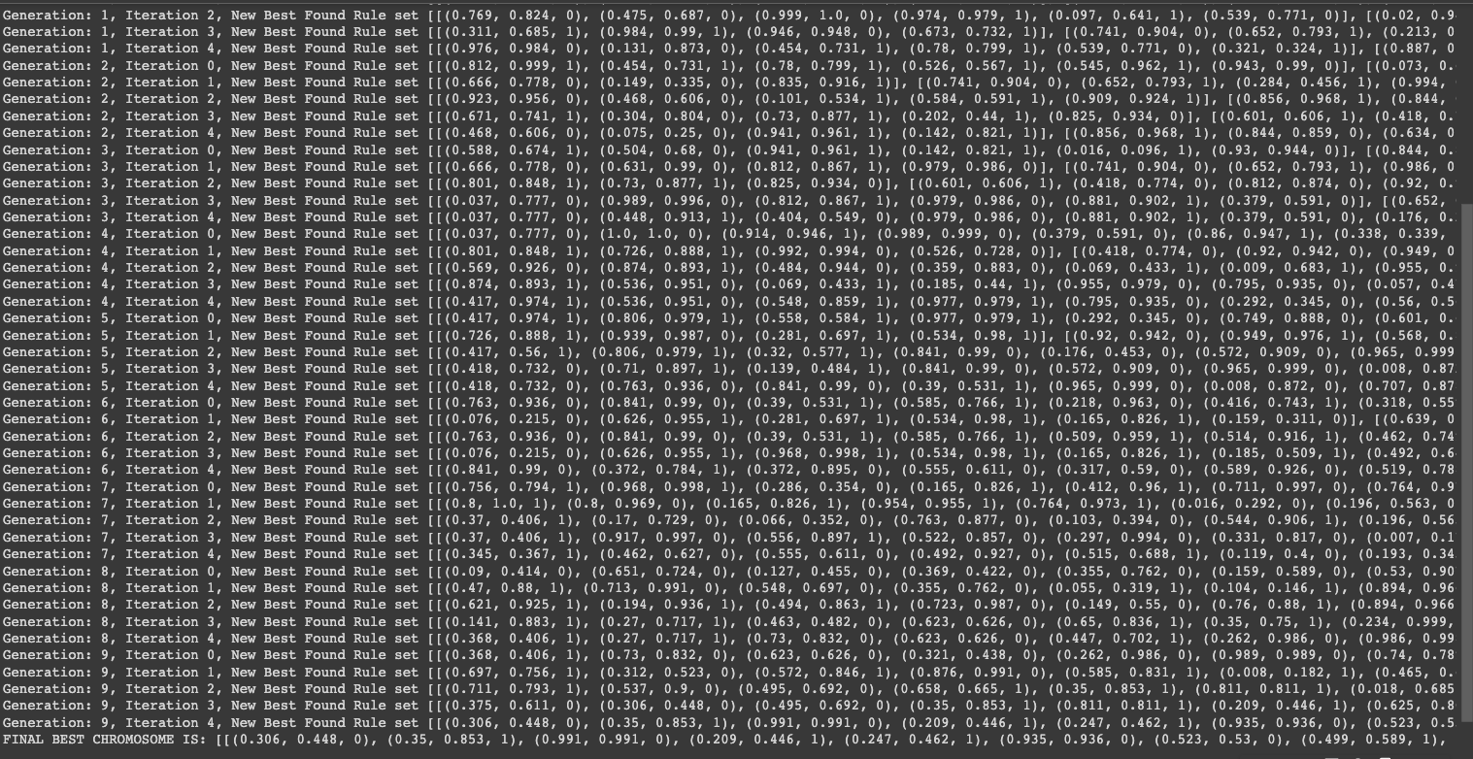
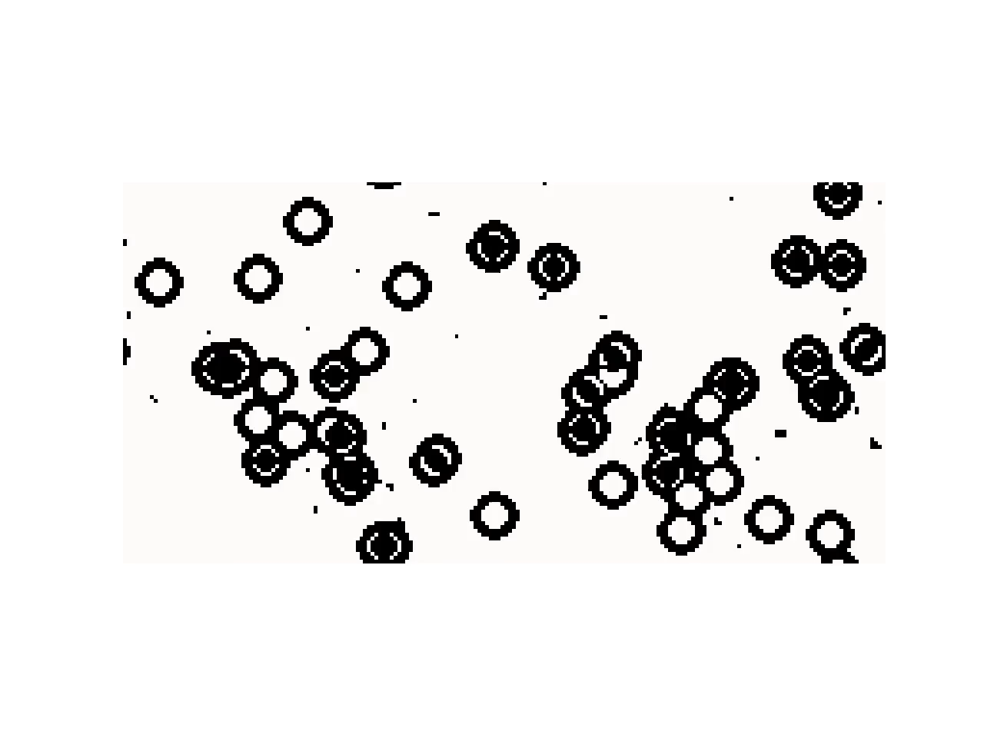
Population = 10, Generation = 10 (ran on cluster), nh=2
File name : emnca_p10_g10.ipynb
Output
FINAL BEST CHROMOSOME IS: [[(0.306, 0.448, 0), (0.35, 0.853, 1), (0.991, 0.991, 0), (0.209, 0.446, 1), (0.247, 0.462, 1), (0.935, 0.936, 0), (0.523, 0.53, 0), (0.499, 0.589, 1), (0.232, 0.375, 1), (0.651, 0.973, 1), (0.267, 0.582, 1), (0.17, 0.548, 1), (0.435, 0.952, 0), (0.233, 0.543, 1), (0.174, 0.993, 0), (0.663, 0.671, 1), (0.202, 0.261, 1)], [(0.381, 0.837, 0), (0.624, 0.98, 1), (0.705, 0.976, 1), (0.46, 0.719, 0), (0.435, 0.715, 0), (0.806, 0.931, 0), (0.723, 0.811, 1), (0.456, 0.913, 0), (0.147, 0.273, 1), (0.9, 0.946, 0), (0.772, 0.879, 1), (0.951, 0.967, 1), (0.423, 0.567, 0), (0.717, 0.829, 1), (0.572, 0.876, 1), (0.922, 0.961, 0), (0.378, 0.681, 1), (0.101, 0.205, 1), (0.288, 0.339, 1), (0.978, 0.986, 1), (0.143, 0.506, 1), (0.638, 0.911, 0), (0.29, 0.687, 1), (0.143, 0.639, 1), (0.936, 0.957, 1), (0.881, 0.967, 0)], [(0.177, 0.377, 1), (0.587, 0.807, 0), (0.057, 0.212, 1), (0.722, 0.844, 1), (0.488, 0.531, 1), (0.344, 0.867, 0), (0.25, 0.556, 0), (0.373, 0.98, 1), (0.953, 0.983, 0), (0.651, 0.96, 1), (0.555, 0.839, 0), (0.035, 0.218, 0), (0.071, 0.31, 0), (0.536, 0.744, 1), (0.373, 0.635, 1), (0.064, 0.975, 1), (0.782, 0.896, 0), (0.023, 0.59, 1), (0.575, 0.949, 0), (0.056, 0.419, 1), (0.02, 0.337, 0), (0.776, 0.899, 1), (0.519, 0.918, 1)]]

Slide 10
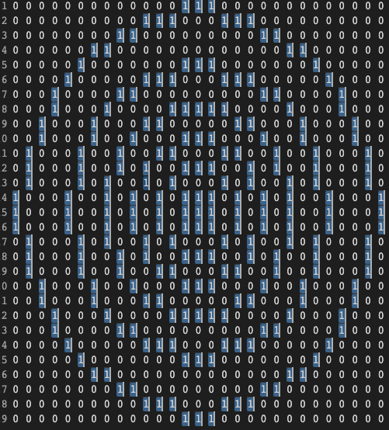
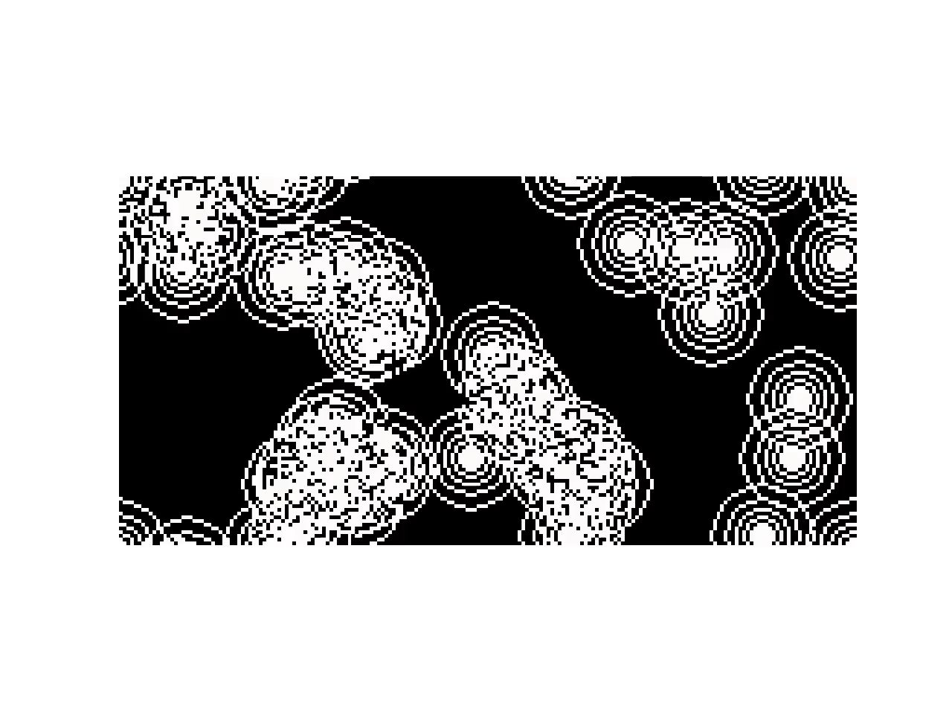
Population = 10, Generation = 10 (running on cluster now) , nh=3
File name - emnca_p10_g10_nh3.ipynb
Output
mask_c1
mask_c2
mask_c3

